Slide 1
Object Oriented Design

Slide 2
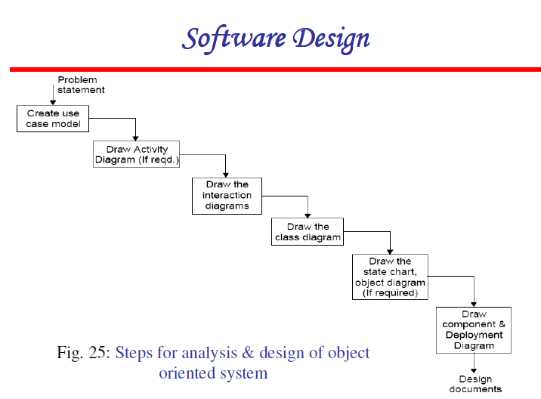

Slide 3
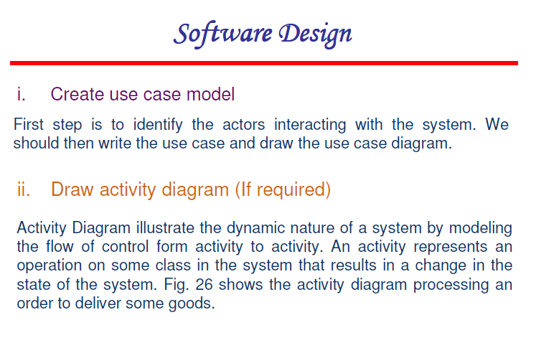

Slide 4
Use Case Diagram
Use cases represents typical set of scenarios that help to structure, relate and understand the essential requirement. A use case diagram is diagram that help system analyst to discover the requirement of target system from the user’s perspective. use case diagram can be used to describe the functionality of system in horizontal way. Use case diagram are used to represent functionality of the system from a top down perspective.
Actors: 1)Librarian : librarian can check availability of book, verify member issue book, calculate fine and return book
2)Member: Member can check availability of book, issue book and return book to system

Slide 5
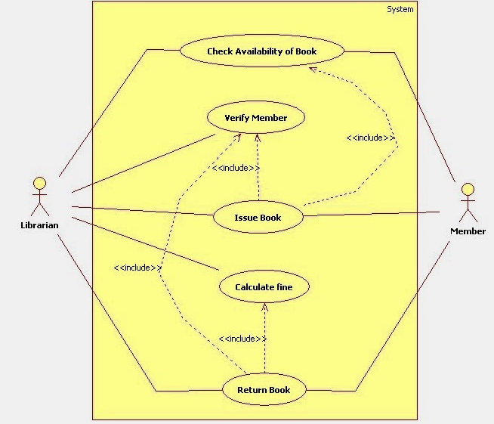
Use Case Diagram of Library Management System

Slide 6
Activity Diagram
Activity diagram is one of the important UML diagram which describes the flow of activity in system. Activity diagram is basically a flowchart which shows connection between one activity of system to another activity. Before drawing activity diagram you should list activity of user and connection between both activity. Activity diagram of library management system may defer according to users such as administrator, customer etc.
Activity of Issuing books to member: The librarian checks the availability of book. If the book is not available, then an error message will be displayed else the check the rack no were the book is placed will be displayed. The member is validated. Depending upon the type of member if more books can be issued to member ,the transaction will be created and issue details are added to the transaction. The book and member details are updated accordingly

Slide 7
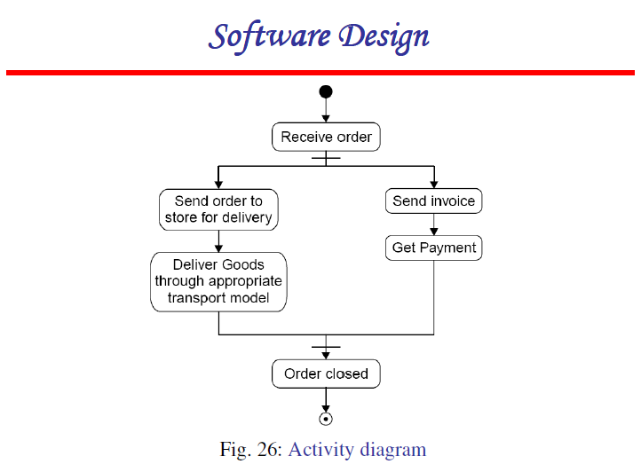

Slide 8
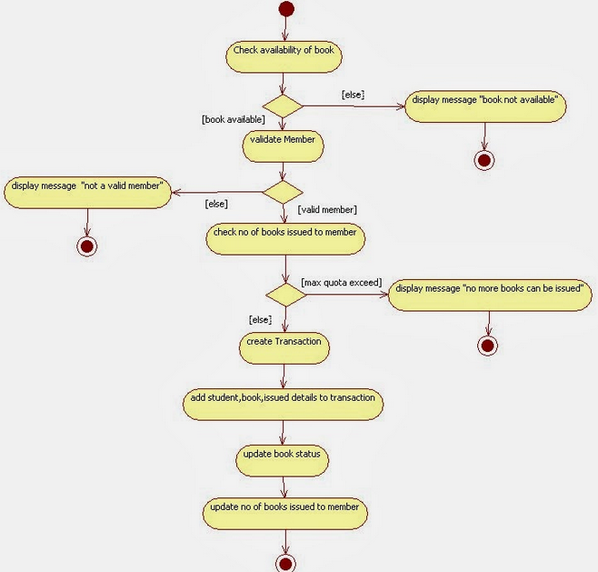
Activity Diagram of Library Management System

Slide 9
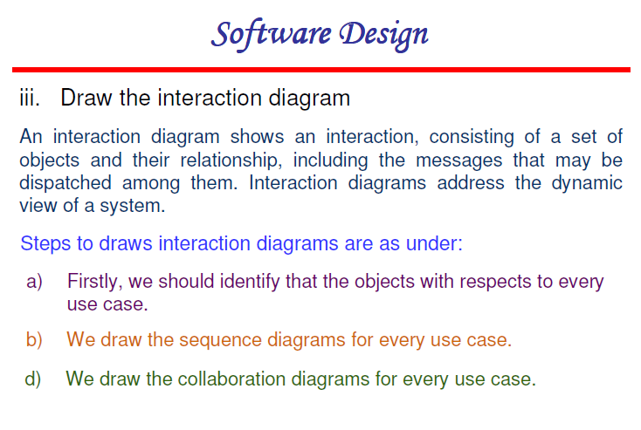

Slide 10
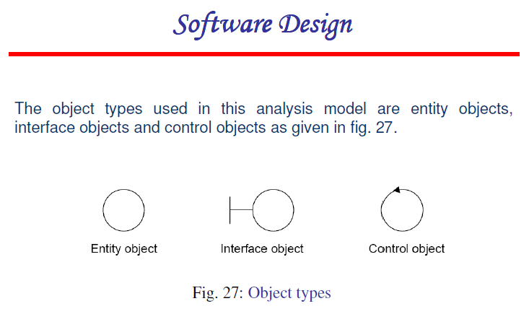

Slide 11
Sequence Diagram
Sequence diagram descries interaction among classes in terms of an exchange of message over time. Sequence diagram demonstrate the behavior of objects in a use case by describing the object and messages they pass. A sequence diagram depicts the sequence of actions that occurs in system. The invocation of methods in each object and the order in which they captured in a sequence diagram. This makes sequence diagram very useful. Sequence diagram in two dimensional in nature.
Librarian Issues a book to member:- Whenever a member asks for a book, the librarian checks the availability of book, if the book is available then the rack number of that book will be returned to librarian. librarian then checks the validity of member by verifying the library card. If member is valid then the number of books issued to him is less then maximum allowed ,books issued to him and transaction is created. librarian then update the number of books issued to member and status of book

Slide 12
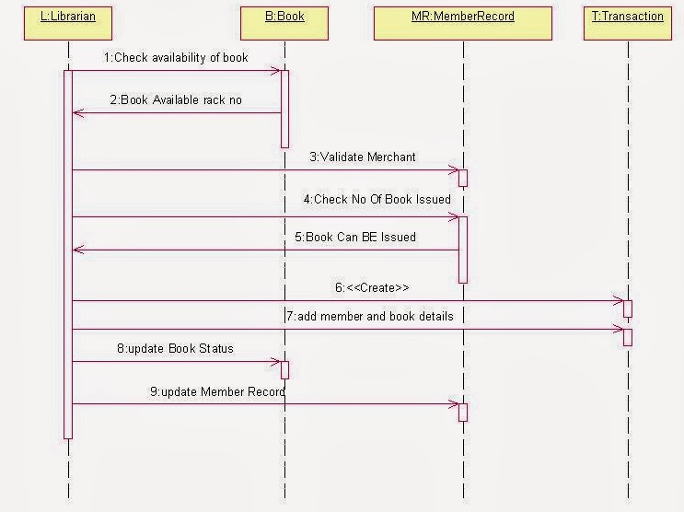
Sequence Diagram of Library Management System

Slide 13
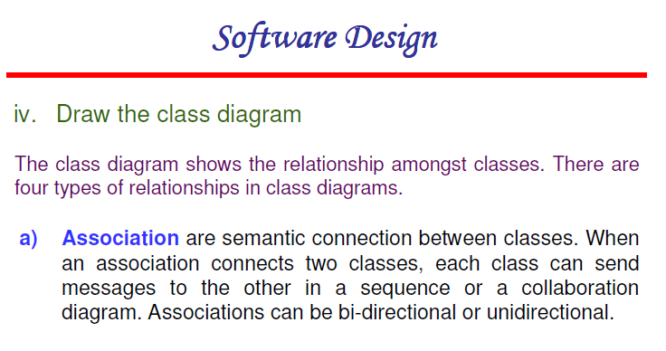

Slide 14
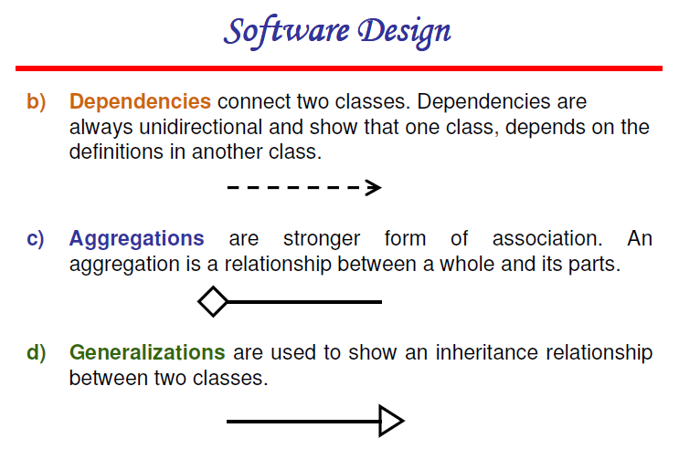

Slide 15
Class Diagrams
Classes are the basic building blocks of an OO system as classes are the implementation units also
Class diagram is the central piece in an OO design. It specifies
Classes in the system
Association between classes
Subtype, supertype relationship

Slide 16
Class Diagram…
Class itself represented as a box with name, attributes, and methods
There are conventions for naming
If a class is an interface, this can be specified by <<interface>> stereotype
Properties of attr/methods can be specified by tags between { }

Slide 17
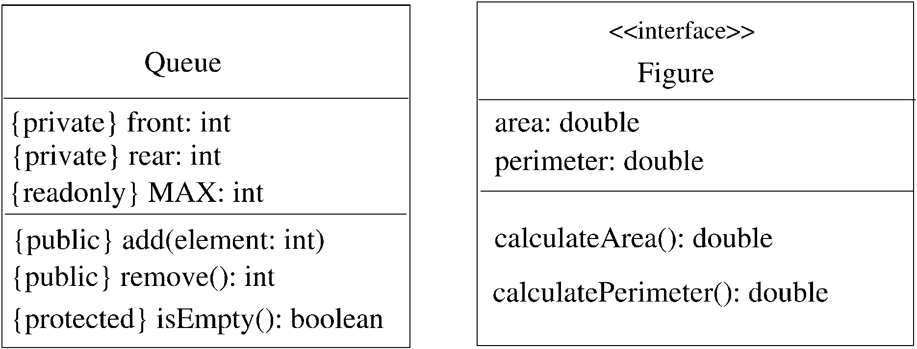
Class – example

Slide 18
Generalization-Specialization
This relationship leads to class hierarchy
Can be captured in a class diagram
Arrows coming from the subclass to the superclass with head touching super
Allows multiple subclasses
If specialization is done on the basis of some discriminator, arrow can be labeled

Slide 19
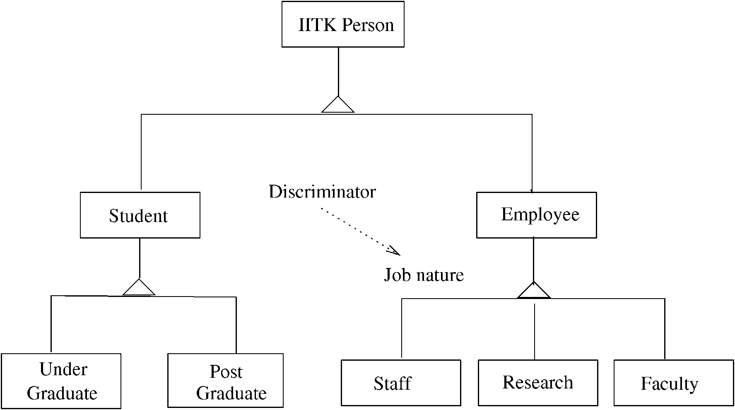
Example – class hierarchy

Slide 20
Association/aggregation
Classes have other relationships
Association: when objects of a class need services from other objects
Shown by a line joining classes
Multiplicity can be represented
Aggregation: when an object is composed of other objects
Captures part-whole relationship
Shown with a diamond connecting classes

Slide 21
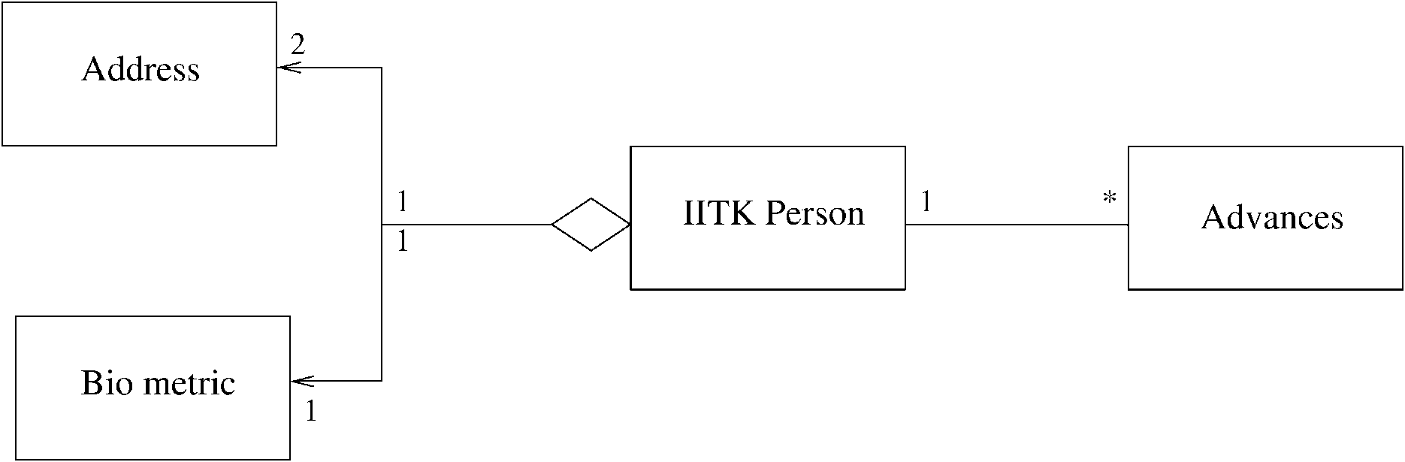
Example – association/aggregation

Slide 22
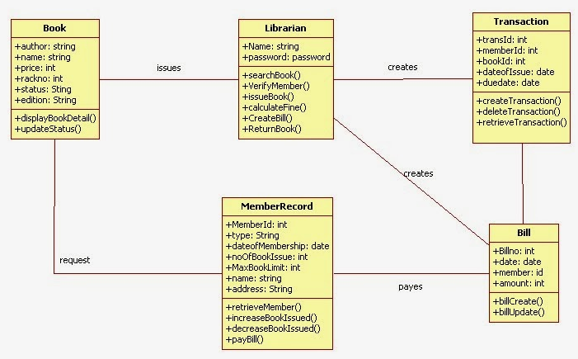
Class Diagram of Library Management System

Slide 23
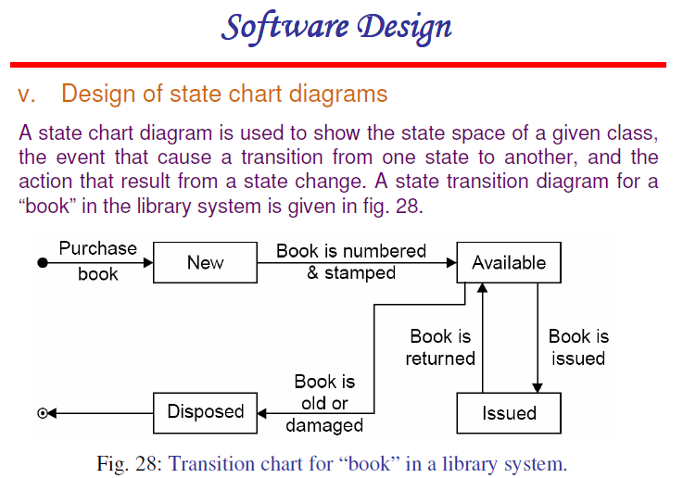

Slide 24
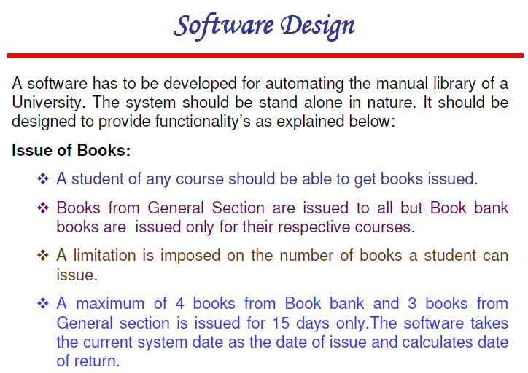

Slide 25
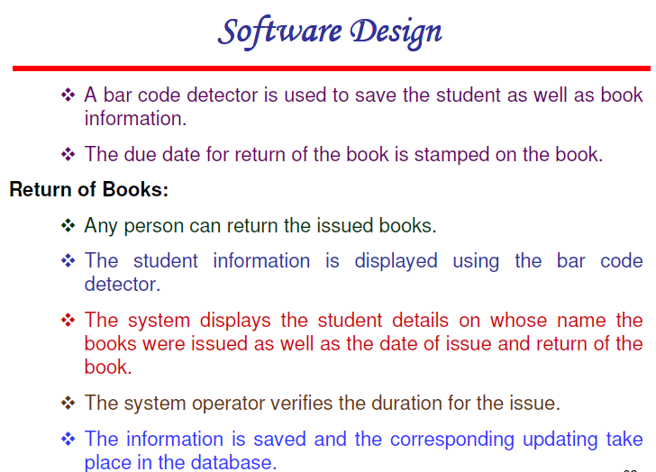

Slide 26
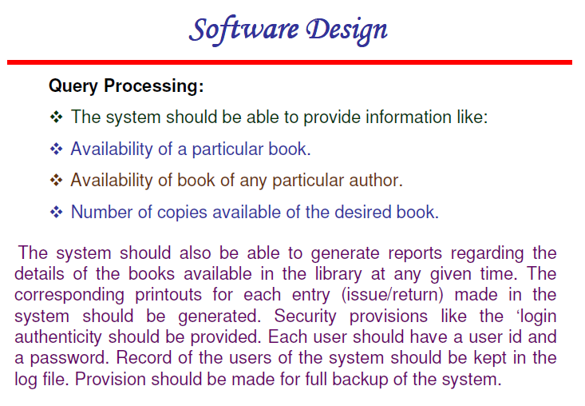

Slide 27
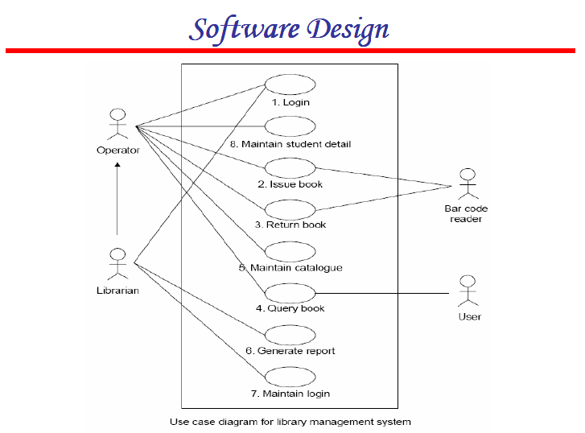

Slide 28
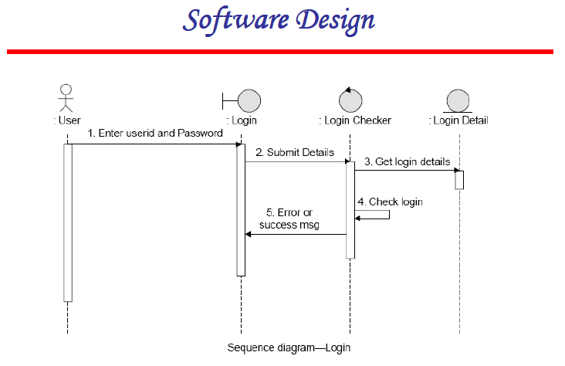

Slide 29
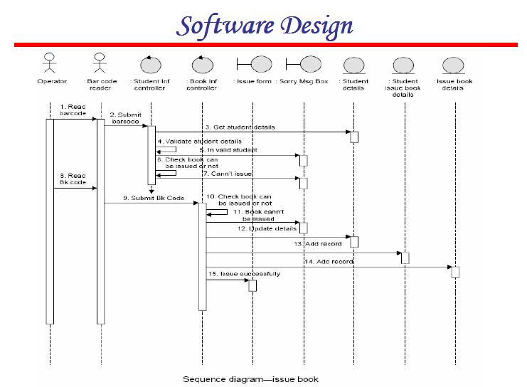

Slide 30
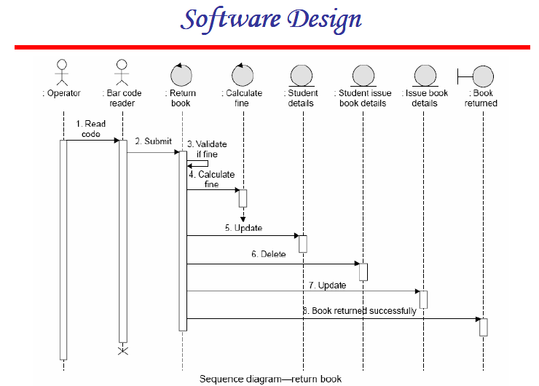

Slide 31
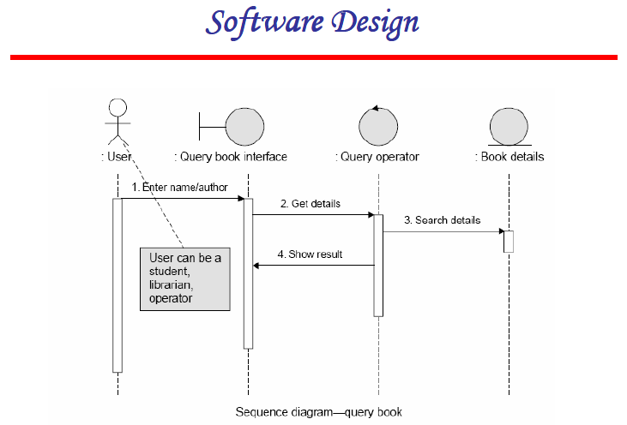

Slide 32
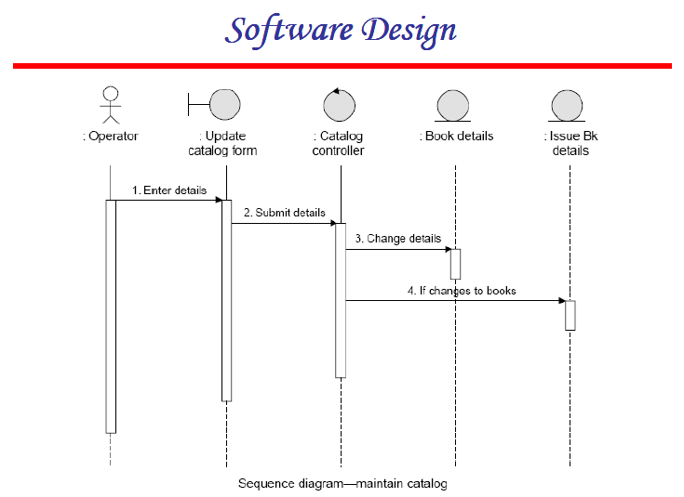

Slide 33
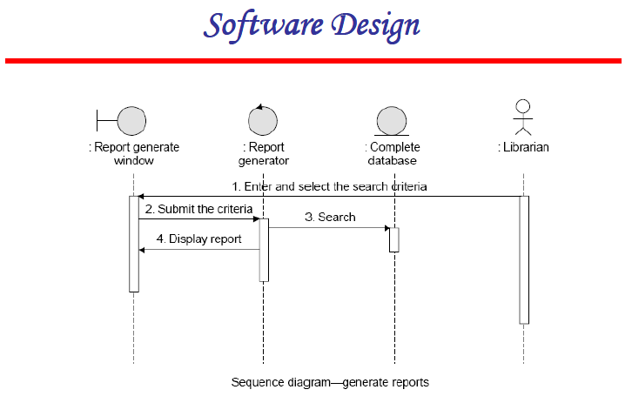

Slide 34
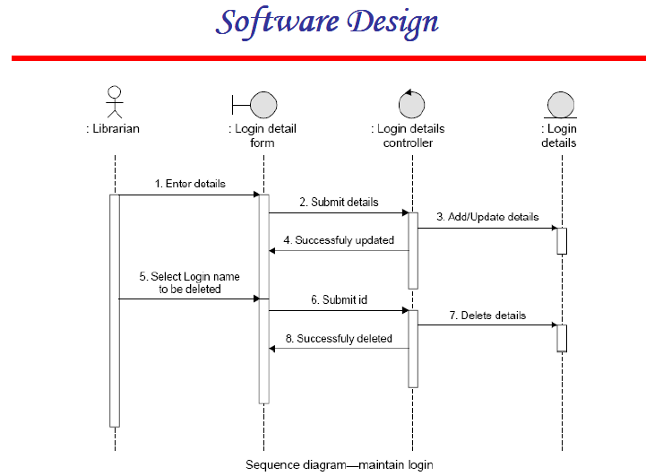

Slide 35
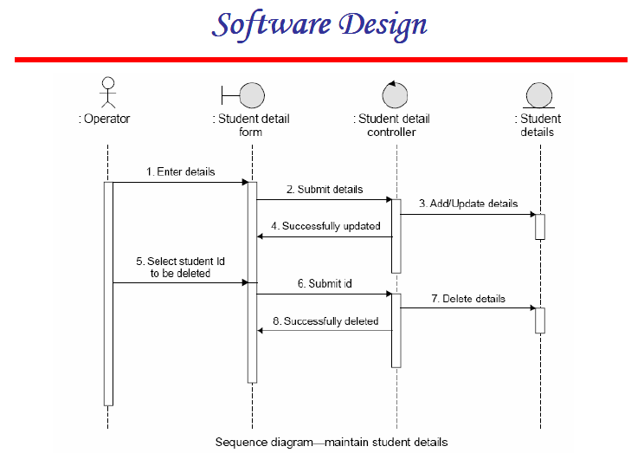

Slide 36
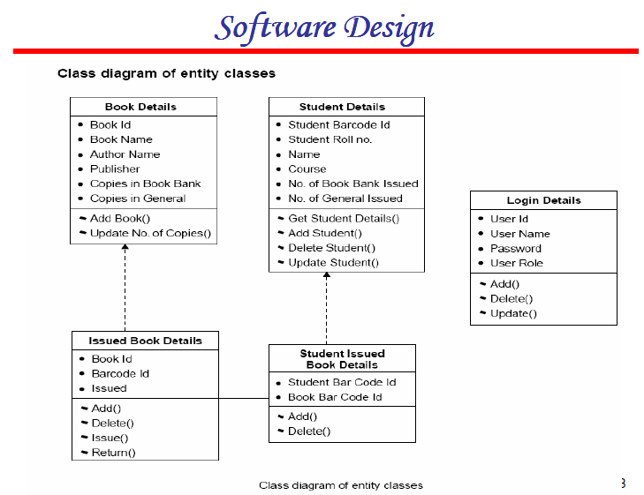

Slide 37
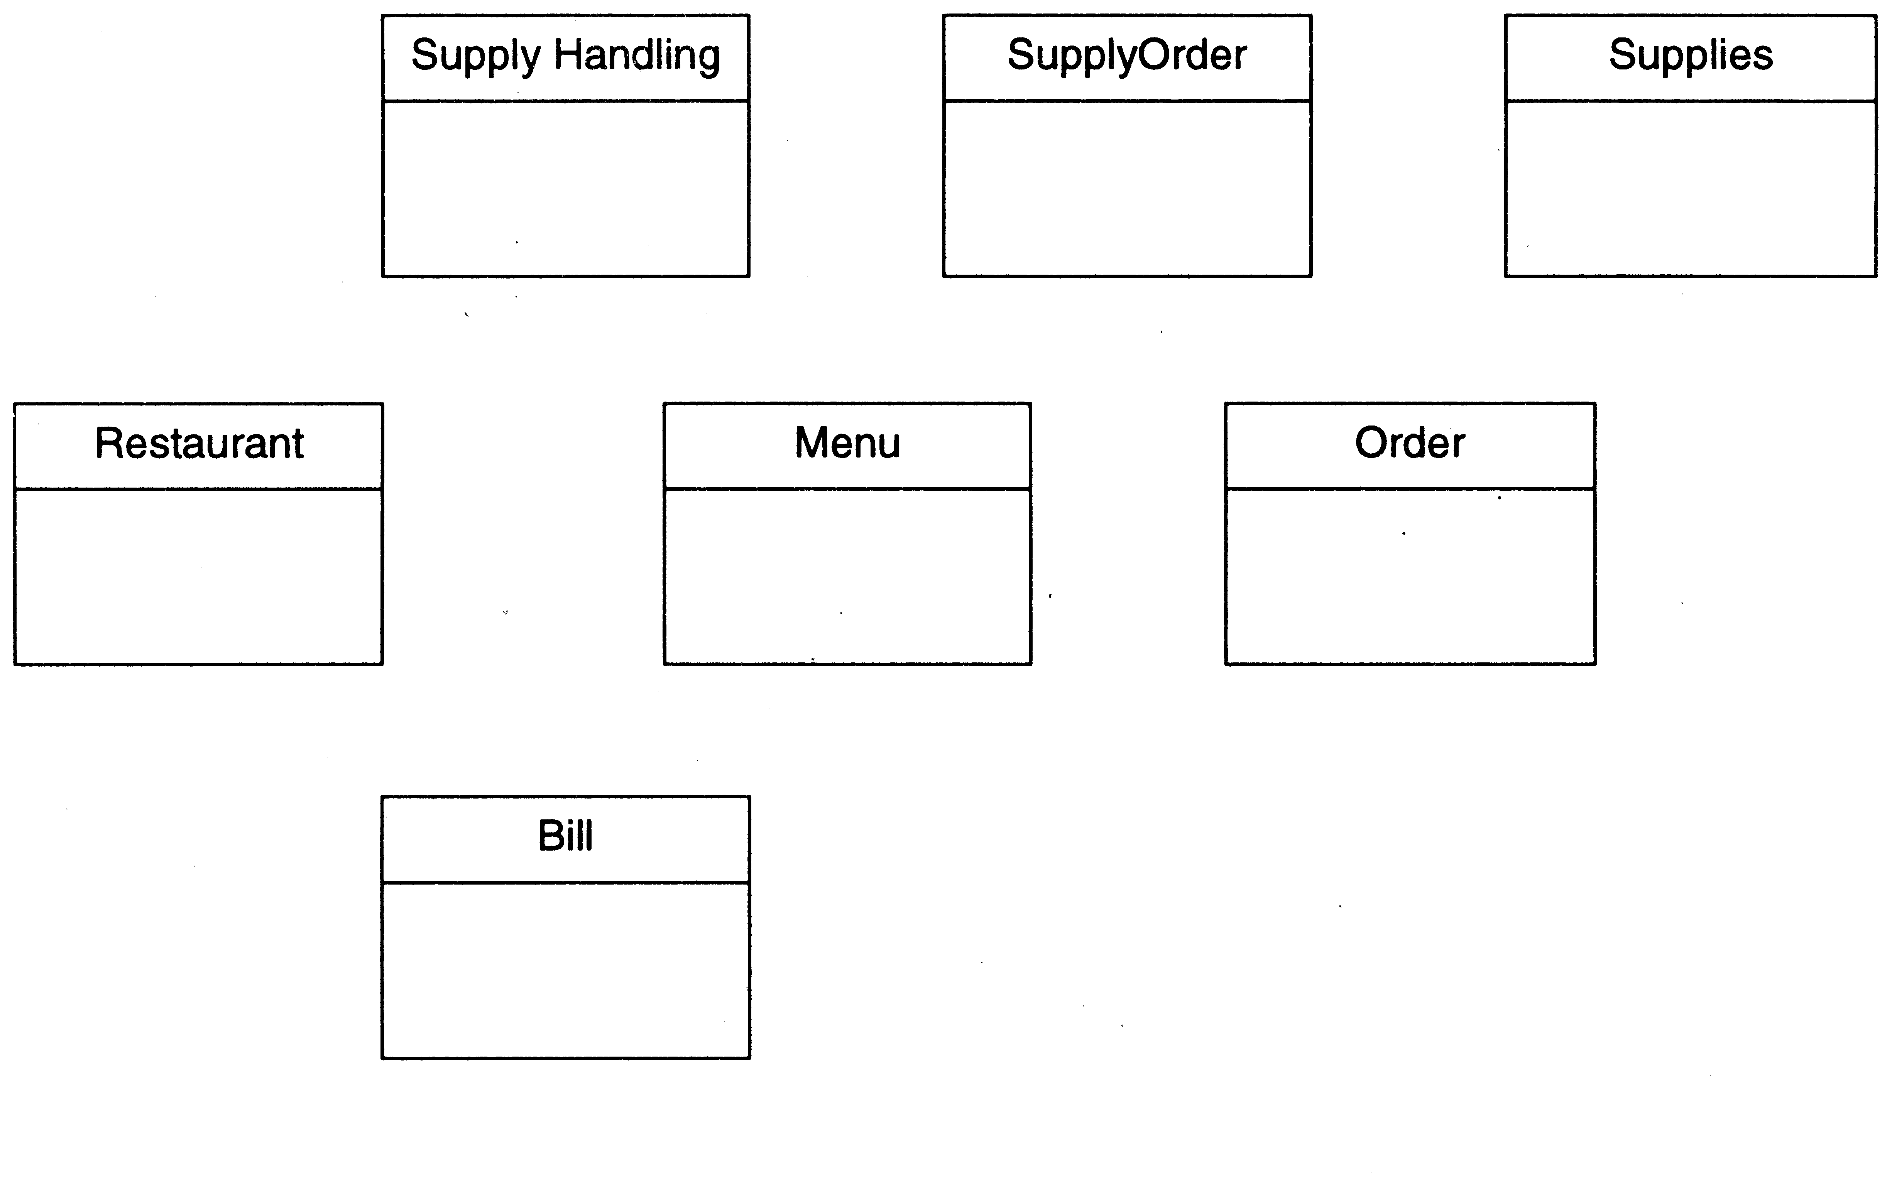
Restaurant example: Initial classes

Slide 38
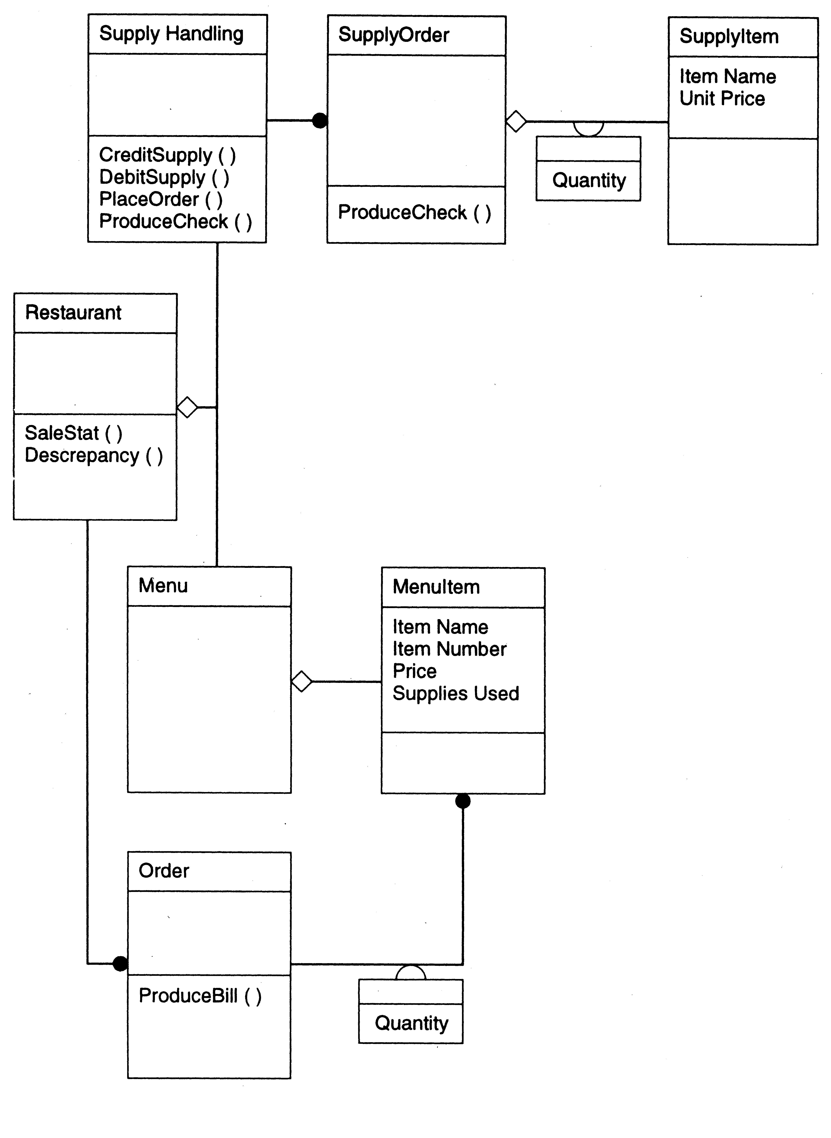

Slide 39
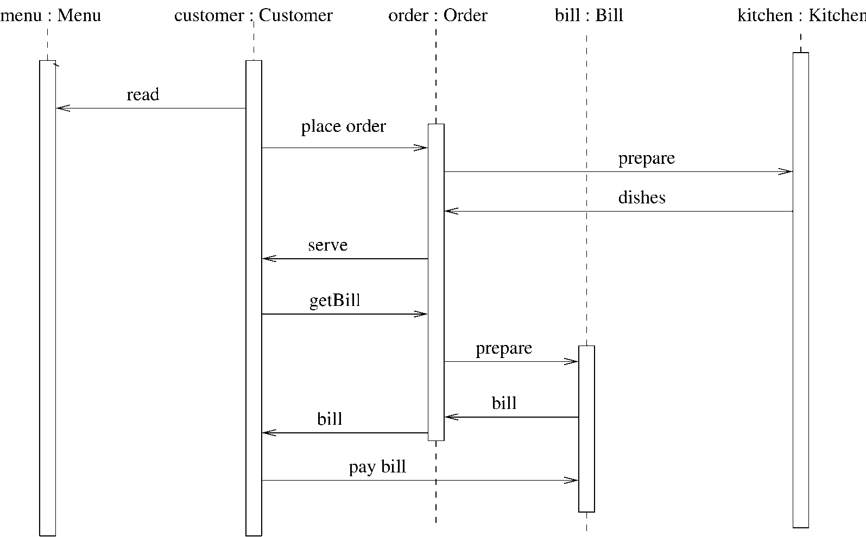
Restaurant example: a seq diag

